Slide 1

Syriatel telecommunication
Customer churn prediction

Slide 2
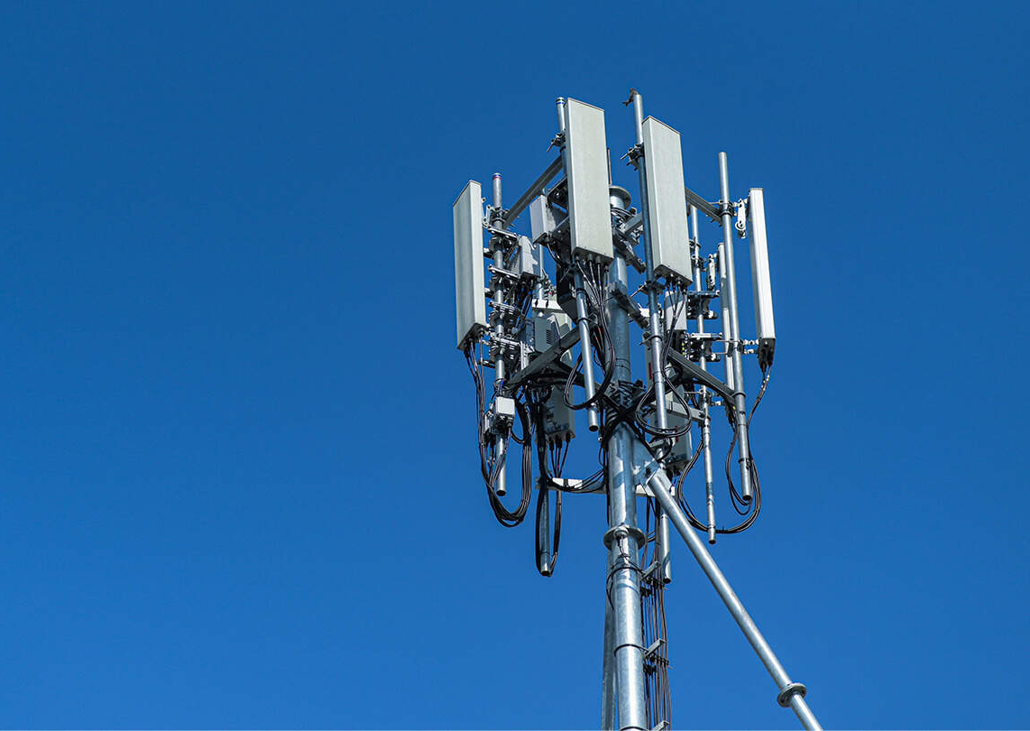
Table of contents
Introduction
Problem statement
Objectives
Patterns and findings
Conclusions
Recommendations

Slide 3

Introduction
Customer churn refers to the loss of customers or subscribers for any reason at all.
The telecommunications industry is competitive and characterized by very high churn rates.
Attracting new customers is both difficult and expensive hence avoiding churn, should be given a higher priority than trying to attract new customers.

Slide 4

Problem Statement
Syriatel has a significant problem with customer churn.
To solve this problem, it needs to identify the customers who are likely to churn and try to keep them.
Machine learning models can help telco’s in predicting the customers who are most likely to churn, based on various factors such as customer usage patterns, payment history, and demographics.
The goal is to build a classifier to predict whether a customer will ("soon") stop doing business with Syriatel so that the company can take action to retain them.

Slide 5

Objectives
Build a model that predicts customer churn with high recall.
Identify the features that influence customer churn.
Provide recommendations to reduce customer churn.

Slide 6

Data used
The data set was obtained from Kaggle.
It contained features such as customer demographics, their usage patterns and subscriptions and payments which can be used to predict customers who are most likely to churn.
The dataset comprises 21 columns with a total of 3333 entries.

Slide 7

Patterns and findings

Slide 8
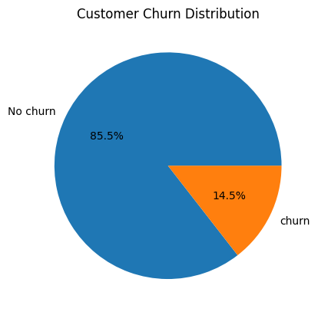
Customer churn distribution
From the chart: 85.5% of customers did not churn (represented by the blue section), meaning they continued to use the product or service. 14.5% of customers did churn (represented by the orange section), meaning they stopped using the product or service

Slide 9
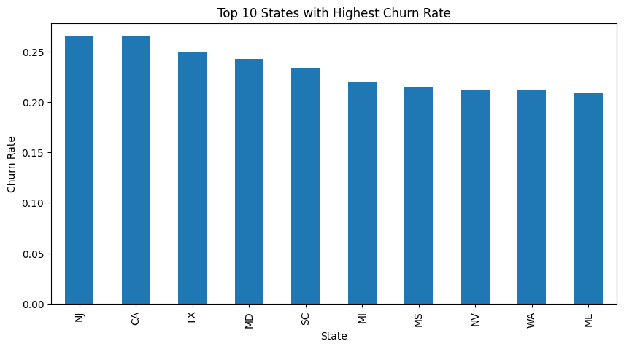
State and churn rates
The top 5 states with the highest churn rate are:
NJ (New Jersey)
CA (California)
TX (Texas)
MD (Maryland)
SC (South Carolina)

Slide 10

Modelling
The data was trained using the following machine learning models:
Logistic Regression.
Random Forest Classifier.
Decision Tree Classifier.
XGB Classifier.

Slide 11
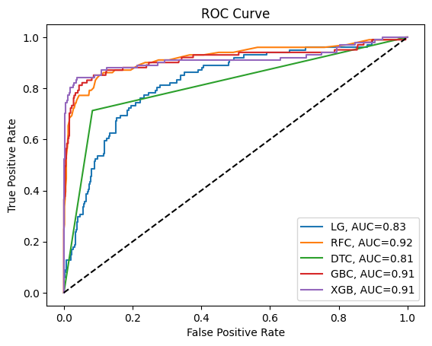
Model evaluation
Logistic Regression (LG): 0.83
Random Forest Classifier (RFC): 0.92
Decision Tree Classifier (DTC): 0.81
Gradient Boosting Classifier (GBC): 0.91
XGBoost Classifier (XGB): 0.91
Random Forest Classifier (RFC) with an AUC of 0.92 is the best model to predict customer churn among the compared models

Slide 12

Model Evaluation
The XGBoost model achieved a recall of 0.79 for churned customers. This means it correctly identified 79% of the actual churn cases.
The XGBoost Classifier ROC score of 0.91 indicates a high level of accuracy in predicting customer churn. This means that the model is able to correctly identify 91% of the cases where customers are likely to leave the service

Slide 13
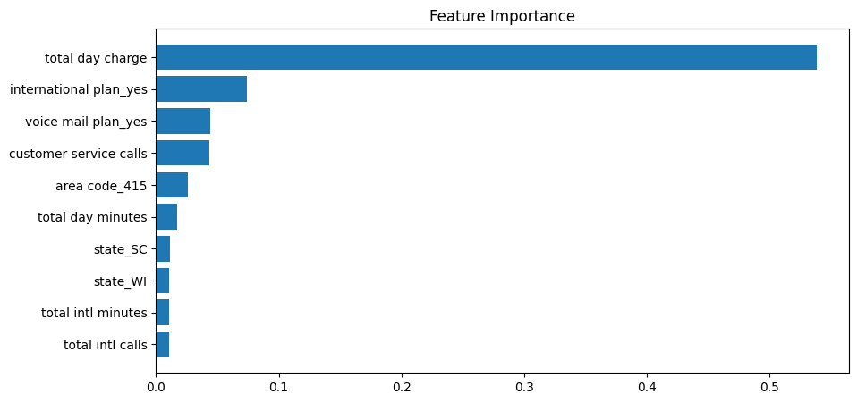
Top five features
The top 5 features that affect customer churn include:
Total Day Charge
International Plan
Voice Mail Plan
Area Code (415)
Customer Service Calls

Slide 14

Conclusion
By leveraging predictive analytics like customer churn prediction, we can proactively address potential issues and tailor the company’s services to meet individual customer needs, thereby enhancing customer satisfaction and loyalty.

Slide 15

Recommendations
XGBoost for predicting customer churn
Enhance international service offerings and review pricing.
Improve voice mail services and offer tutorials or assistance.
Customer care team should strengthen customer support, resolve issues effectively, and enhance service quality.
Improve network quality

